Slide 1

Catch a third wave
Stakeholder briefing
Notes:
problem statement (goal)
evaluation metrics (user perspective)
proposed timeline (as proposed at the beginning) plus where is one on the timeline
current findings about the data/EDA
approaches and current results wrt goal
future work

Slide 2
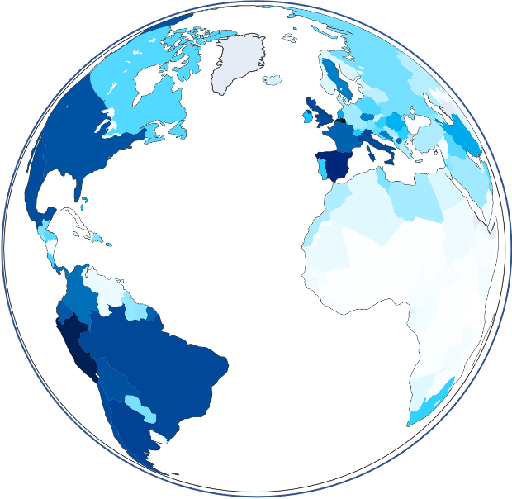
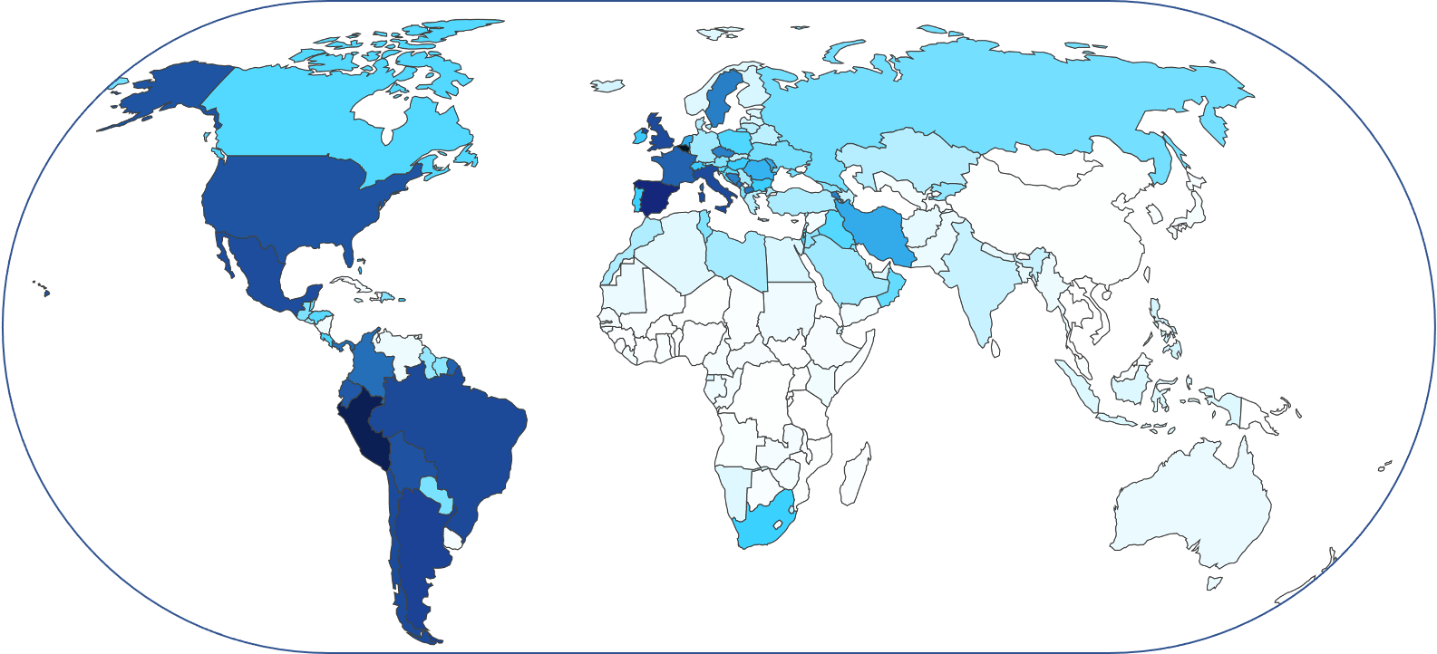
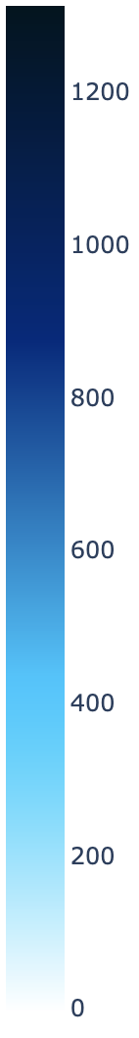
TOTAL COVID-19 DEATHS PER MILLION
Notes:
State: 19 November 2020
Most deaths in Peru
Probably for some countries more accurate than for others.
No data on: Turkmenistan, Mongolia, North Korea, Cambodia, Laos and maybe some Island states or city states (and this map doesn’t show Greenland but we also dont have data on data)

Slide 3
—DR. TEDROS ADHANOM GHEBREYESUS, WORLD HEALTH ORGANIZATION’S DIRECTOR GENERAL
“We cannot say this loudly enough or clearly enough or often enough: All countries can still change the course of this pandemic”

Slide 4
HOW?
MASK WEARING
SOCIAL DISTANCING
Effective measures to flatten the curve?
A global comparison.

Slide 5
GOAL
Increase awareness of the impact of mask wearing and social distancing on the number of COVID-19 cases world wide.
What is the course of the pandemic for:
More adhering populations
Less adhering populations.

Slide 6
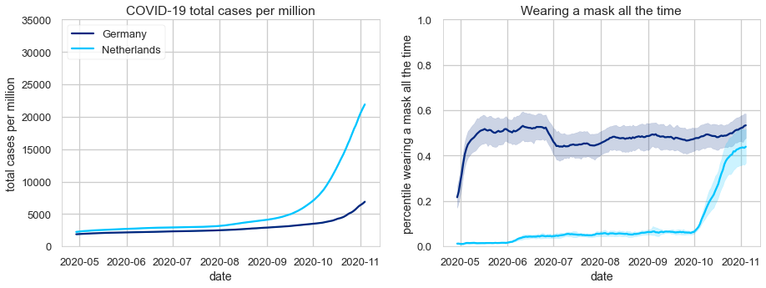
ADHERING TO MASK WEARING
Notes:
Wear mask all the time when in public.

Slide 7
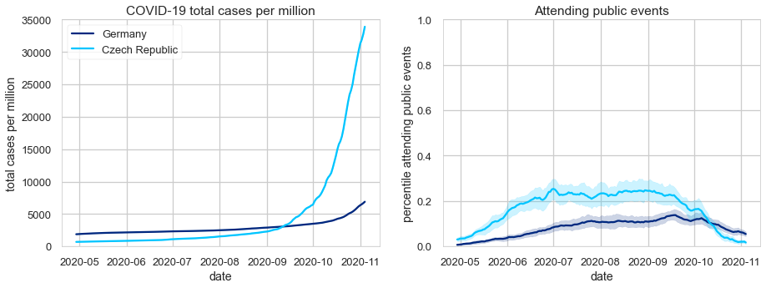
ADHERING TO SOCIAL DISTANCING
Notes:
Want to compare similar countries.
Estimated percentage of people reporting that they attended a public event with more than 10 people in the last 24 hours

Slide 8
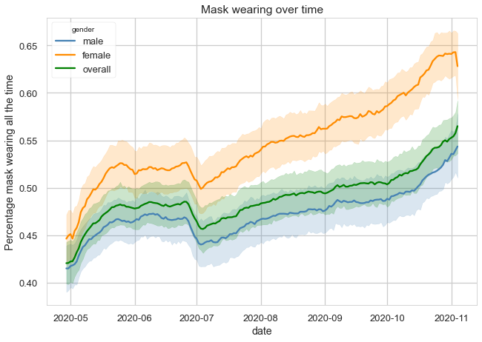
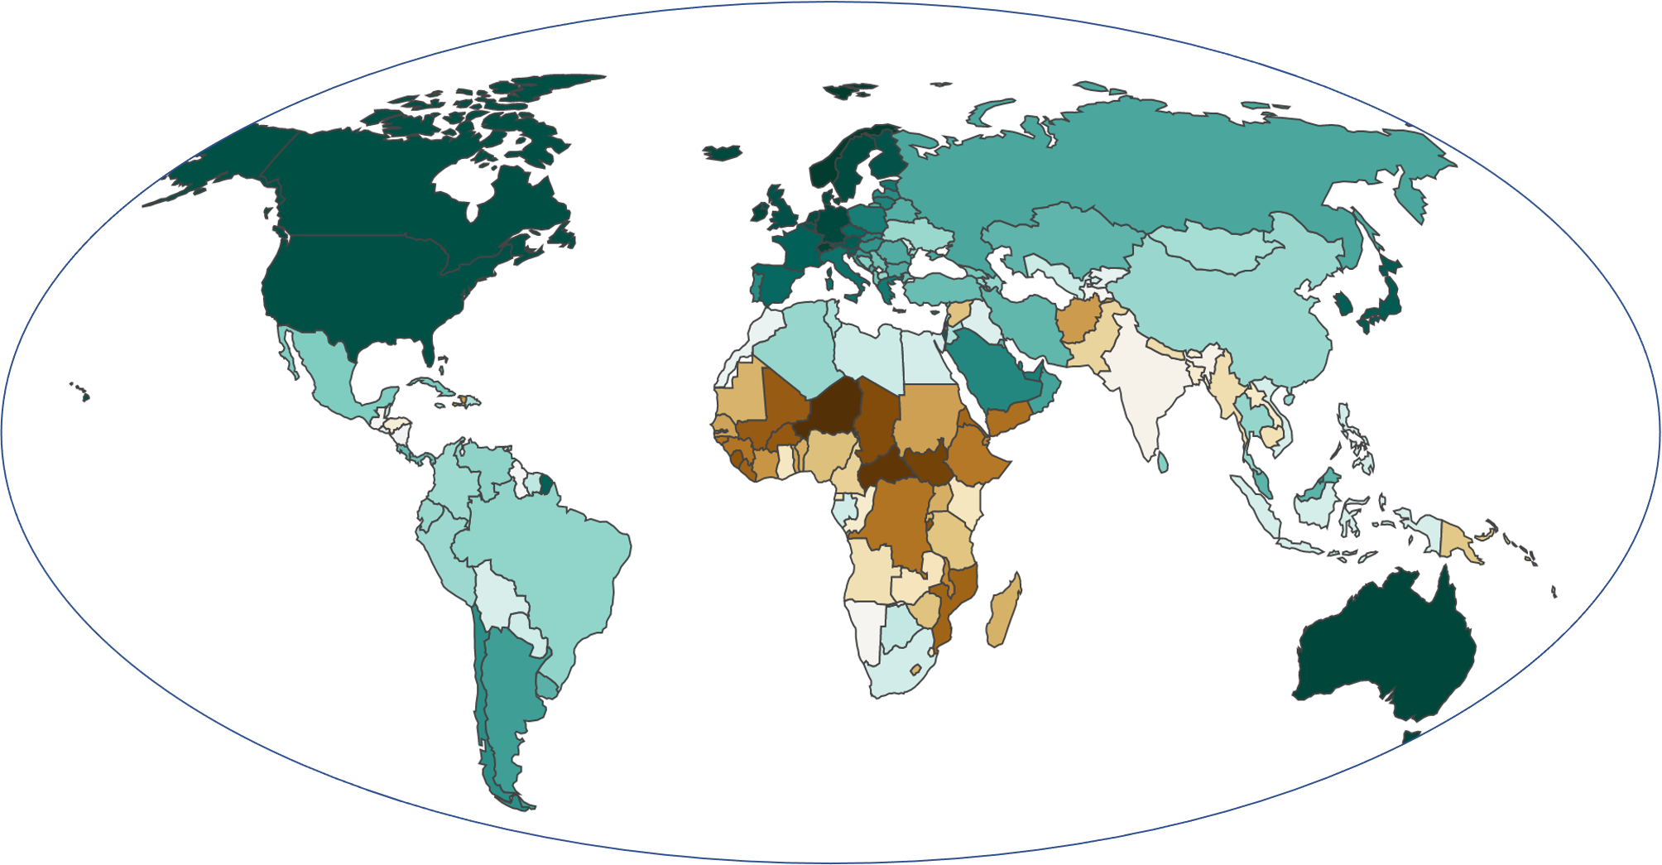
FACTORS: MASK-WEARING
DATE & GENDER
HDI
Notes:
Date - beginning some, summer sloppy, second wave twice as many people wearing masks
Gender - males sloppier mask wearing
ASIA higher HDI the more people wear masks
Europe - higher HDI fewer wear masks
Worldwide - more people never wear mask for HDI below 0.55 and above 0.9

Slide 9

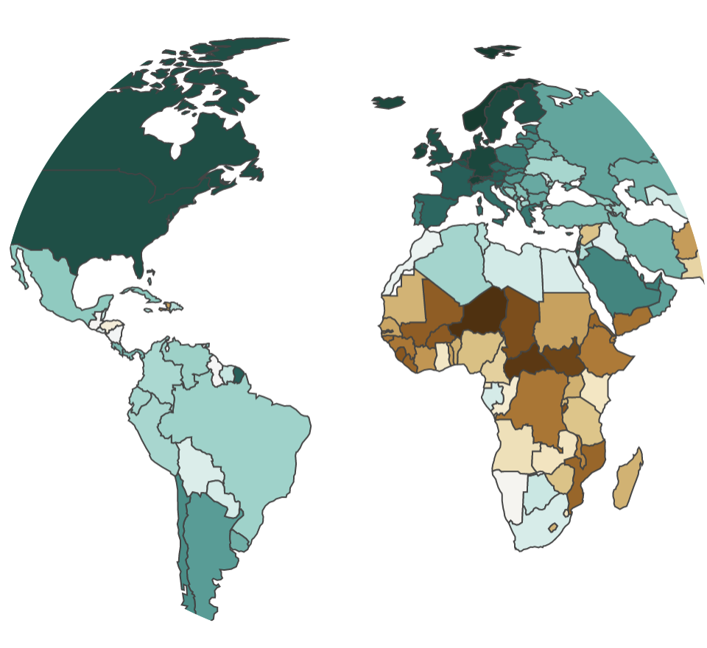




FACTORS: SOCIAL DISTANCING
GENDER
AGE
DATE
HDI

Slide 10
APPROACH
Predict the number of COVID-19 cases in a country.
How does changing measures regarding mask wearing or social distancing affect the course of the pandemic for a country?
Predictions allow an error rate of 20%.
Under-predicting means people won’t do as advised.
Over-predicting means people fear unnecessarily.

Slide 11
TIMELINE
WEEK 03
WEEK 01
Modelling data,
Interactive Dashboard
Understanding data
WEEK 02
WEEK 04
Visualizing data
Finalizing the project
Extras: Tweets, Preferred Interpersonal Distance

Slide 12
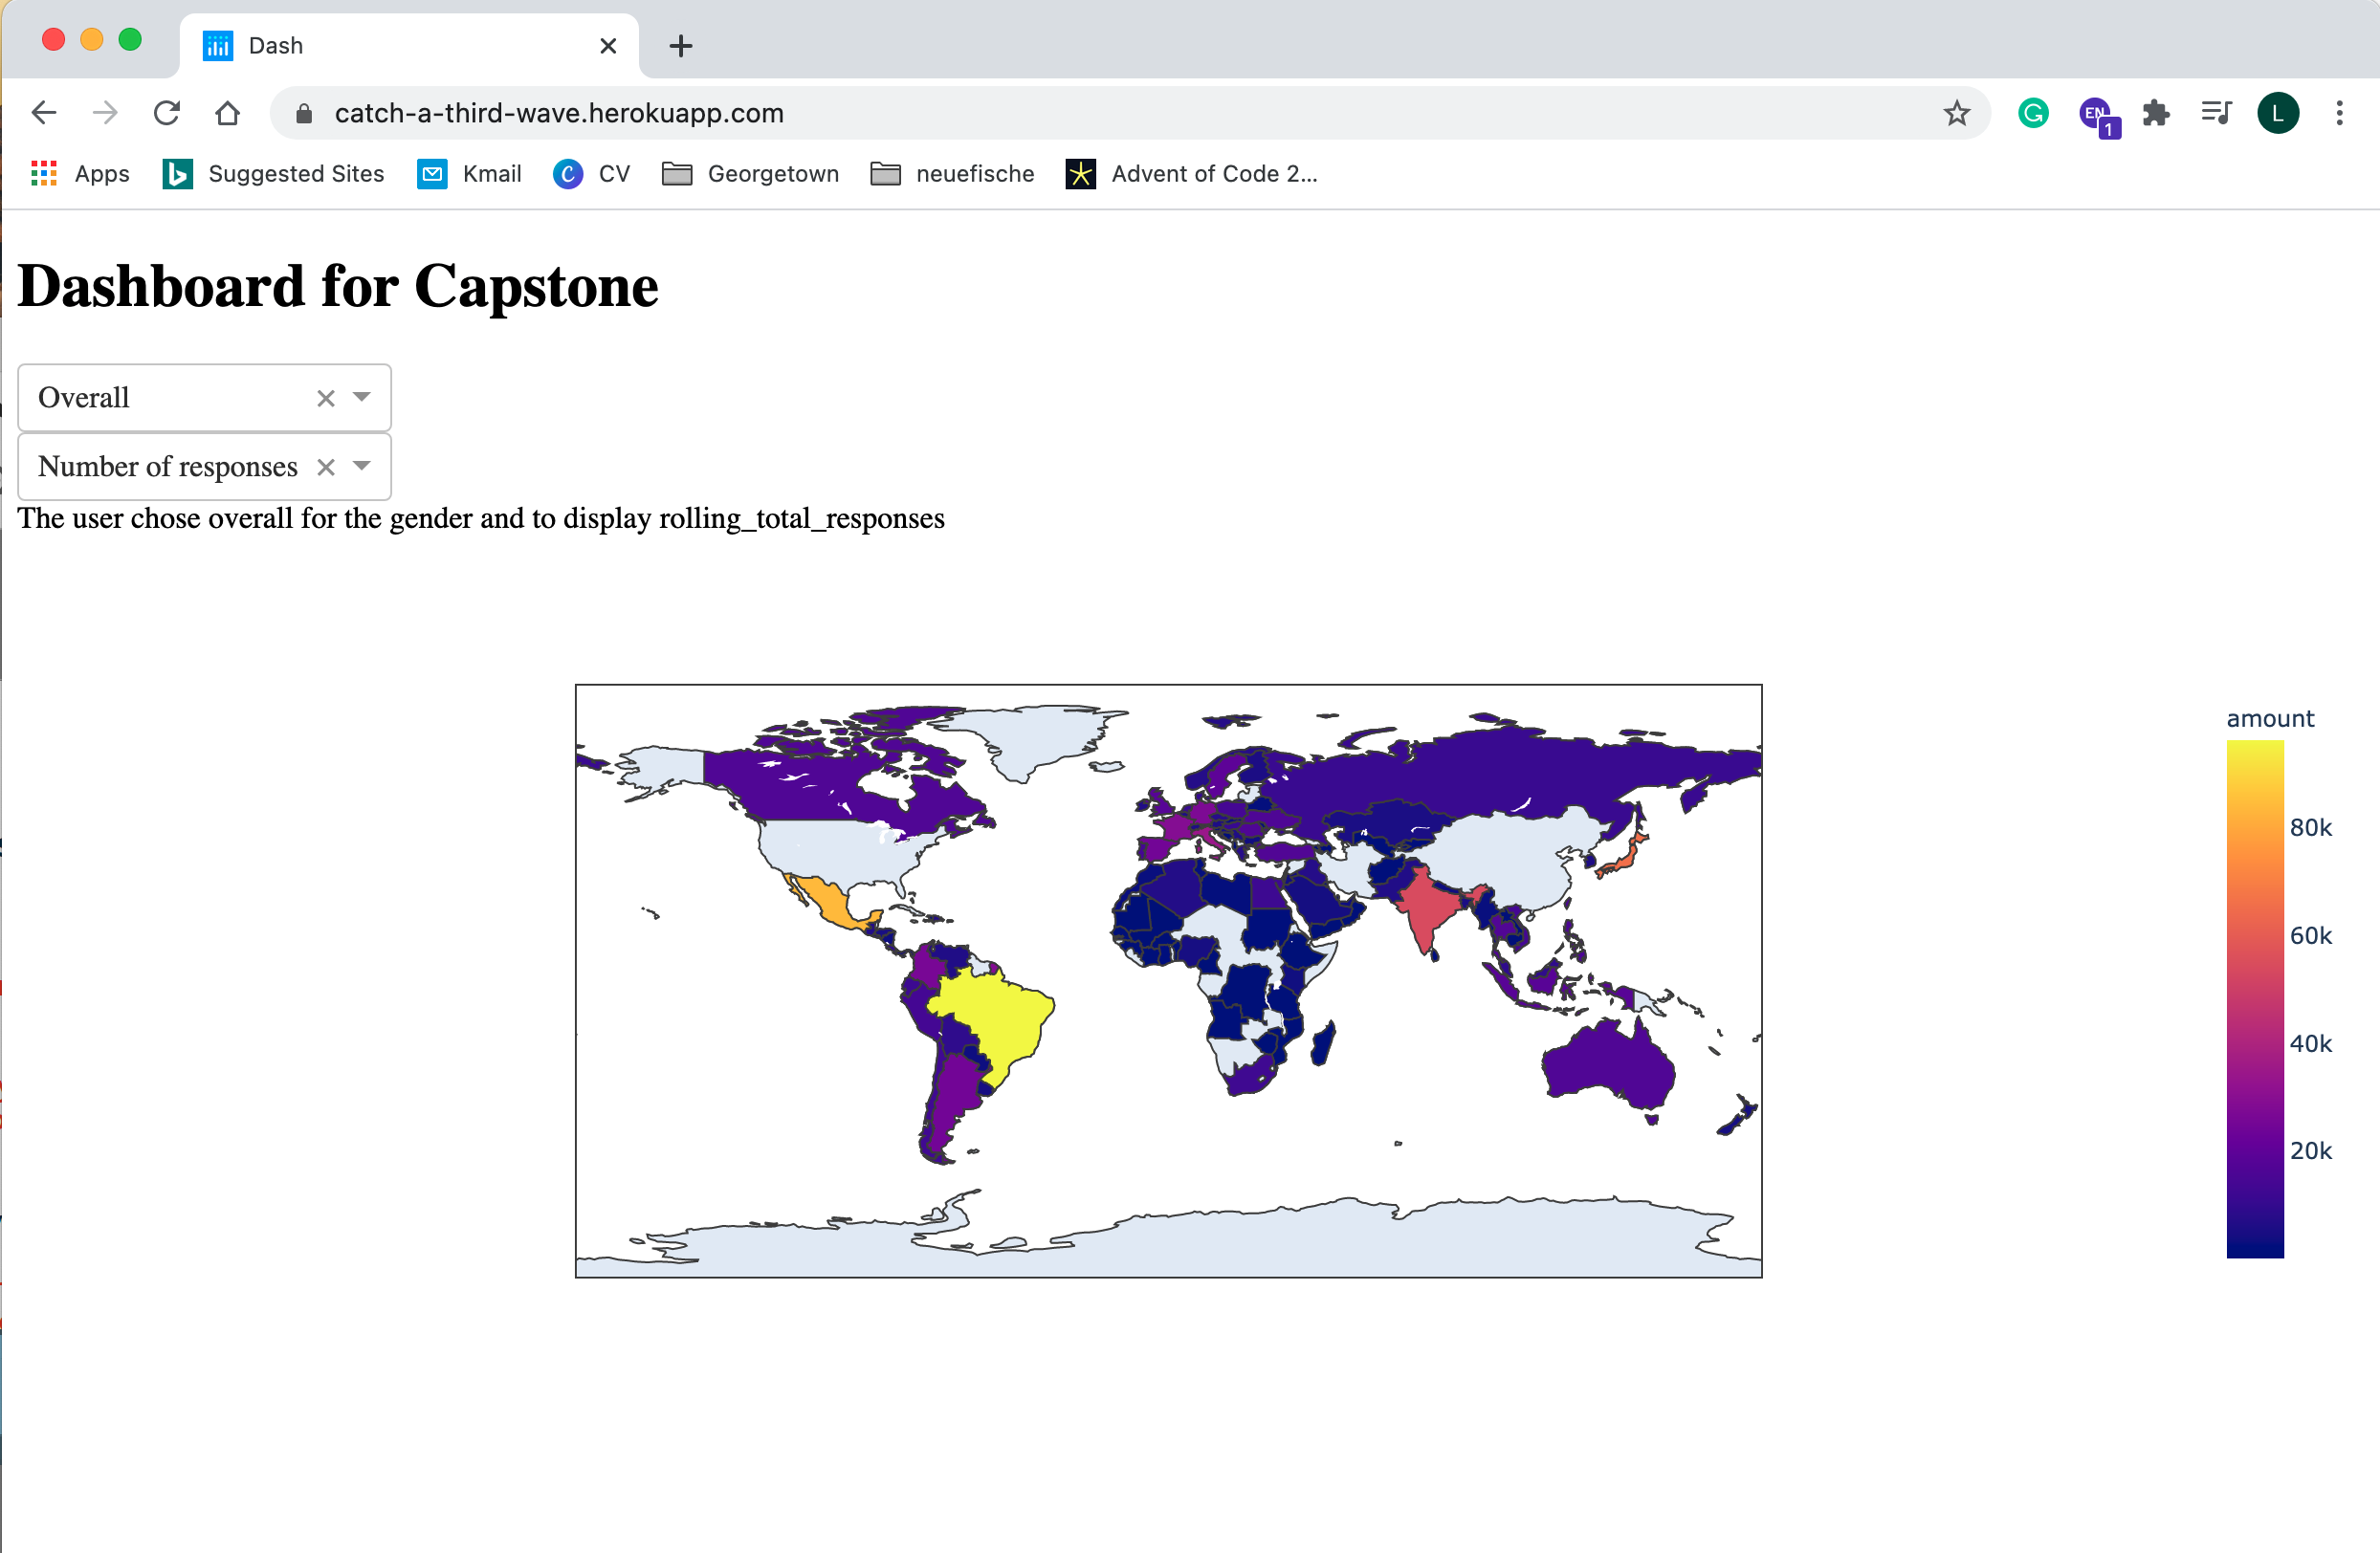
DASHBOARD
Basic prototype of interactive dashboard with a drop down menu to visualise different data. E.g.:
Number of COVID cases per million
Percentage of people wearing masks
https://catch-a-third-wave.herokuapp.com/

Slide 13
THANKS!

